Slide 1
Redpoint Introduction
2023

Slide 2




At Redpoint we create
perfect customer experiences
for leading brands all over the world.
Brands that are global, diverse and unique.

Slide 3
Brands with a variety of challenges …
SILOED
DATA
NO SINGLE
CUSTOMER
VIEW
INABILITY TO
MAKE THE MOST OF
FIRST PARTY DATA
POOR
CUSTOMER
EXPERIENCE
LIMITED SEGMENTATION
& PERSONALISATION
DATA
QUALITY
ISSUES
NEEDS ARE NOT
BEING MET BY
TECHNOLOGY IN PLACE
LACK OF
SUPPORT
FOR REAL-TIME
USE CASES
SILOED
CHANNELS,
INCONSISTENT
MESSAGING
CONCERNS
ABOUT COOKIE
CHANGES
POOR
CAMPAIGN
PERFORMANCE
SCV CANNOT BE
LEVERAGED ACROSS
ALL TOUCHPOINTS

Slide 4

Redpoint is uniquely qualified to address these challenges
INDEPENDENT
SOFTWARE
VENDOR
GLOBAL
CLIENT
BASE
IN BUSINESS
17+ YEARS
100% FOCUSED ON
DATA, INSIGHT &
CUSTOMER ENGAGEMENT

Slide 5
We know what it takes to create perfect customer experiences
CREATE THE “GOLDEN RECORD”
INTELLIGENTLY ORCHESTRATE INTERACTIONS
DELIVER COMPELLING MARKETING
MOMENTS
CONNECT
THE DATA.
ALL OF IT.
PINPOINT NEXT BEST ACTION
Data Quality
Siloed Data Integration
Identity Resolution
Advanced Matching
Recommendations
Optimisation
Segmentation
Activation
Multi-channel Customer Journeys
CX Transformation
Real-time, Enterprise-wide Engagement

Slide 6
Our Platform - rg1

Slide 7
Introducing the rg1 platform
A single point of operational control for data and CX delivery
CUSTOMER
DATA
PLATFORM
JOURNEY
ORCHESTRATION
REAL-TIME
INTERACTION
Automated data quality, identity resolution
for every source of customer data.
‘Golden records’, segmented & activated
Next best offer, action or message
in context & cadence of
campaigns and journeys
Consistent CX
across real-time touchpoints
Connectors & API’s
AI & Machine Learning
Deployment flexibility

Slide 8


The same three core capabilities flexibly deployed
Choose Cloud
Choose Flex
(Redpoint’s private cloud & on-premise option)
When you’d like Redpoint to:
take care of your data for you
maintain an accurate and up-to-date ‘single customer view’ on your behalf
provide your marketers with easy access for selection and activation and, optionally:
- journey orchestration
- real-time personalisation
When:
you need to keep your data inside your own firewalls
you (or your implementation partner) want to have total, hands-on control of data engineering processes
when your data (and business requirements) may be complex
when self-sufficiency may be a goal

Slide 9
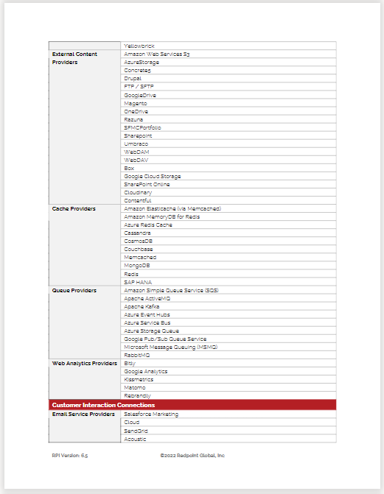
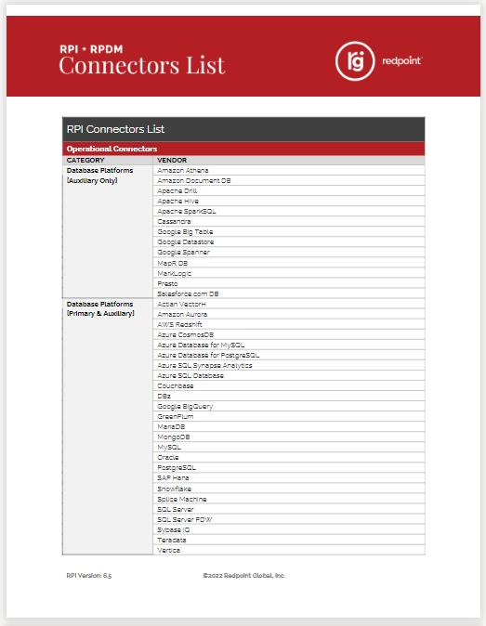
Supported connectors
Redpoint provides over 100 ‘no code’ connectors for leading MarTech, AdTech and adjacent technologies:
Examples include:
Salesforce Marketing Cloud
Salesforce CRM
SendGrid
Twilio
Airship
Amazon SES
Facebook
Instagram
Twitter
Google Ads
YouTube
Microsoft Dynamics
Oracle Responsys
Google Big Table
Amazon S3
Apache Kafka
Amazon SQS
Acoustic
Google Analytics
Braze
Vibes
Survey Monkey
Live Ramp
And many more…

Slide 10











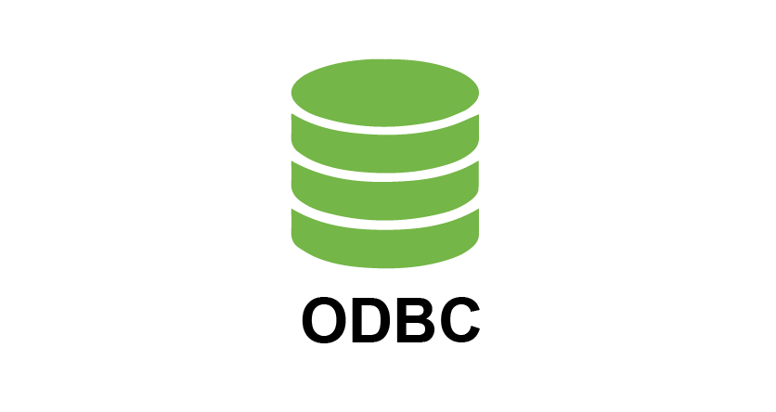


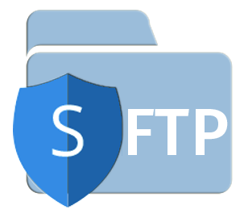
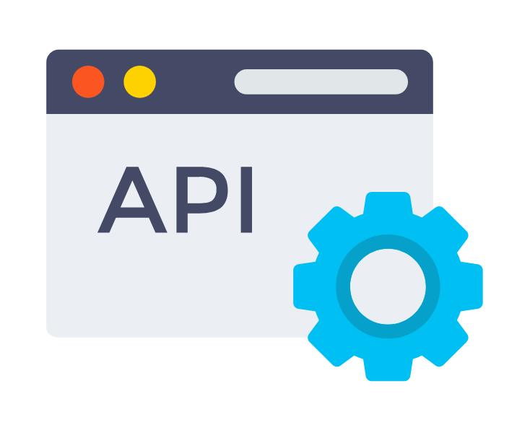


rg1 logical architecture
Source Systems & Data Providers
rg1 Platform
Channel Solutions & Data Consumers
Solution Layer
Customer Data Platform
Journey Orchestration
Real-Time Interactions
Customer
Data
Outreach
Channels
Identity Resolution
Campaign Design
Offer Design
Profile Access
Contextual Decisions
Social/Ad
Channels
Behavioral
Data
Data Quality
Intelligence Layer
Interactive
Channels
Transaction
Data
Customer Insights
Triggers
Personalization
Segmentation
Activation
Integration Layer (Connectors)
Enterprise
Apps/DBs
Event
Data
Publish/Subscribe
Cloud Storage
BI & Analytic
Ecosystems
Reference
Data
Supporting Platforms
Events/
Middleware
Analytics &
Modelling
CMS/
DAM
Enrichment
Data Providers
Response Data

Slide 11
What The Analysts Say

Slide 12
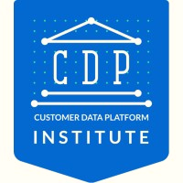
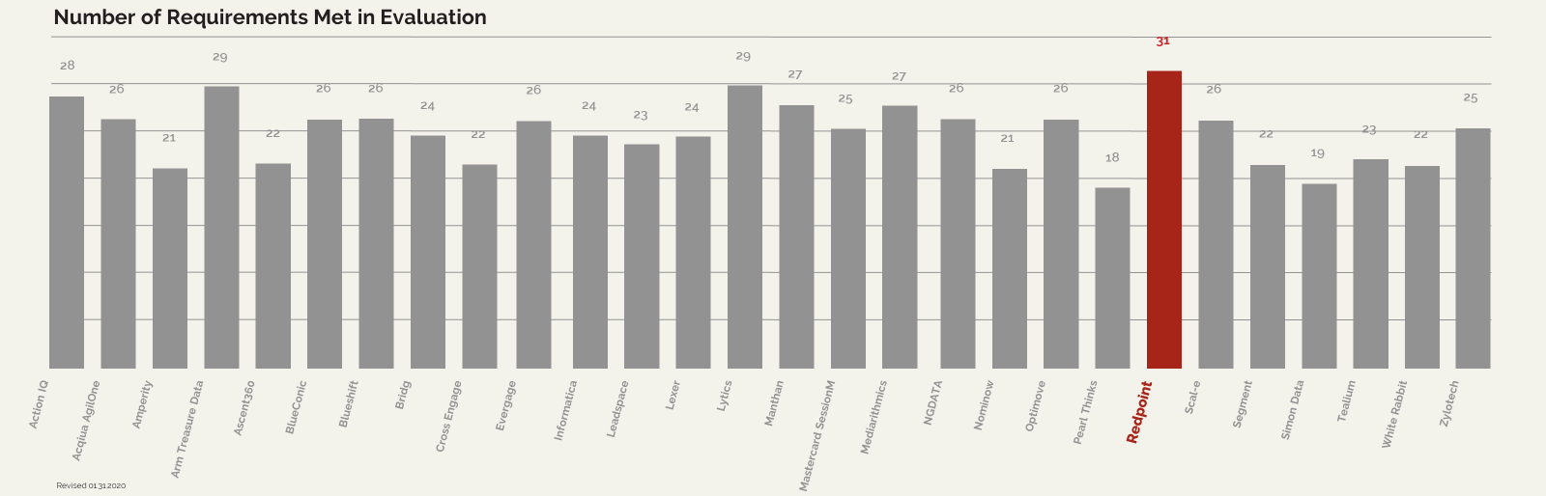
The experts choose Redpoint
Redpoint was the only company to meet all 31 of 31 evaluation requirements in the CDP Institute’s “Vendor Comparison Report”

Slide 13


The experts choose Redpoint
RealCDP Audit - rgOne Offers “One of the Most Comprehensive Set of Native Capabilities in the CDP Space.”
Core
CDP
5 of 5
CDP
Enhancement
6 of 6
CDP
Stack
3 of 3
Ingest Data
Maintain Data
Store Historical Data
Unified Customer Profile
Share Customer Data
Channels & Connectors
3rd Party Applications
Real Time Updates
Real Time Customer Profile
Data Hygiene
End User Training
Analytics
Personalization
Journey Orchestration

Slide 14
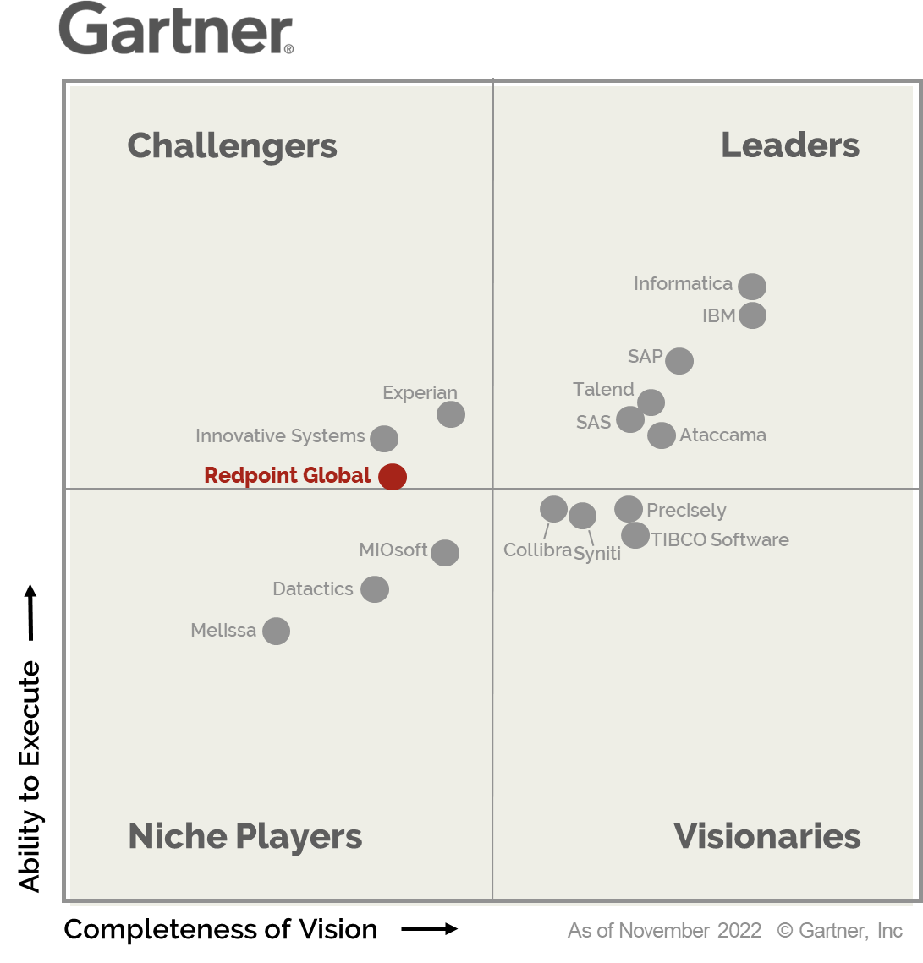
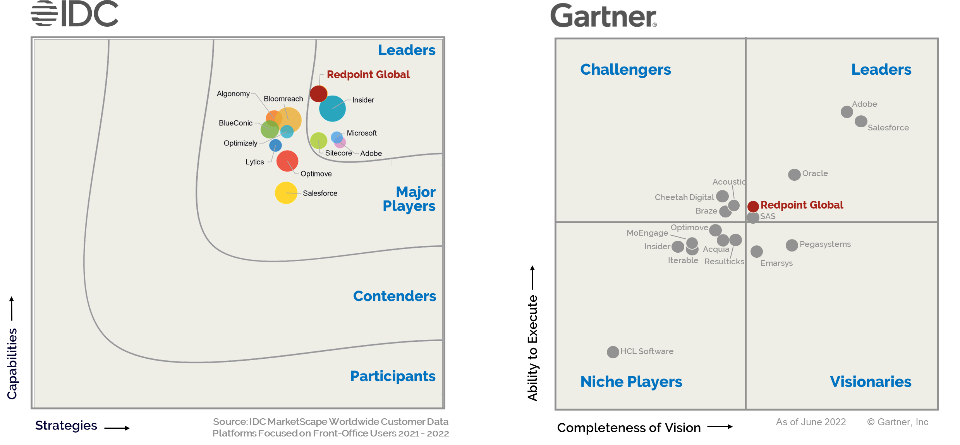
High ratings all around
Redpoint is the only CDP company competing in
both Gartner’s Multichannel & Data Quality Categories / Reports
Data Quality
Customer Data Platform
Multichannel Marketing

Slide 15
Key Differentiators
DATA-FIRST CDP.
Real-time, clean, accurate golden records for each identity.
Market-leading matching & data quality capabilities.
REAL-TIME CUSTOMER EXPERIENCES.
Real-time data ingestion, real-time decisioning, real-time activation.
Market-leading journey orchestration.
FLEXIBLE DEPLOYMENT.
Your cloud, our cloud, YOUR CHOICE.

